Slide 1


Lecture 16: MSTs
Answer the Warm Up:
PollEv.com/champk
CSE 373: Data Structures and Algorithms

Slide 2
Dijkstra’s Algorithm Warmup
Answer the Warm Up:
PollEv.com/champk
0
∞
start
2
B
A
1
1
∞
2
5
E
∞
1
∞
1
D
C
5
3
∞
2
6
G
Vertex | Known? | distTo | edgeTo
A |  | ∞
B |  | ∞
C |  | ∞
D |  | ∞
E |  | ∞
F |  | ∞
G |  | ∞
∞
10
F
Order Added to Known Set:
Notes:
Can print this on the worksheet

Slide 3
Dijkstra’s Algorithm Warmup
0
∞
start
2
B
A
1
1
∞
2
5
E
1??
1
2??
1
D
C
5
3
∞
2
6
G
Vertex | Known? | distTo | edgeTo
A | Y | 0 | /
B |  | ∞
C |  | ≤ 2 | A
D |  | ≤ 1 | A
E |  | ∞
F |  | ∞
G |  | ∞
∞
10
F
Order Added to Known Set:
A

Slide 4
Dijkstra’s Algorithm Warmup
0
6??
start
2
B
A
1
1
2??
2
5
E
1
1
2??
1
D
C
5
3
6??
2
6
G
Vertex | Known? | distTo | edgeTo
A | Y | 0 | /
B |  | ≤ 6 | D
C |  | ≤ 2 | A
D | Y | 1 | A
E |  | ≤ 2 | D
F |  | ≤ 7 | D
G |  | ≤ 6 | D
7??
10
F
Order Added to Known Set:
A, D

Slide 5
Dijkstra’s Algorithm: Example #2
0
6??
start
2
B
A
1
1
2??
2
5
E
1
1
2
1
D
C
5
3
6??
2
6
G
Vertex | Known? | distTo | edgeTo
A | Y | 0 | /
B |  | ≤ 6 | D
C | Y | 2 | A
D | Y | 1 | A
E |  | ≤ 2 | D
F |  | ≤ 4 | C
G |  | ≤ 6 | D
4??
10
F
Order Added to Known Set:
A, D, C

Slide 6
Dijkstra’s Algorithm: Example #2
0
3??
start
2
B
A
1
1
2
2
5
E
1
1
2
1
D
C
5
3
6??
2
6
G
Vertex | Known? | distTo | edgeTo
A | Y | 0 | /
B |  | ≤ 3 | E
C | Y | 2 | A
D | Y | 1 | A
E | Y | 2 | D
F |  | ≤ 4 | C
G |  | ≤ 6 | D
4??
10
F
Order Added to Known Set:
A, D, C, E

Slide 7
Dijkstra’s Algorithm: Example #2
0
3
start
2
B
A
1
1
2
2
5
E
1
1
2
1
D
C
5
3
6??
2
6
G
Vertex | Known? | distTo | edgeTo
A | Y | 0 | /
B | Y | 3 | E
C | Y | 2 | A
D | Y | 1 | A
E | Y | 2 | D
F |  | ≤ 4 | C
G |  | ≤ 6 | D
4??
10
F
Order Added to Known Set:
A, D, C, E, B

Slide 8
Dijkstra’s Algorithm: Example #2
0
3
start
2
B
A
1
1
2
2
5
E
1
1
2
1
D
C
5
3
6??
2
6
G
Vertex | Known? | distTo | edgeTo
A | Y | 0 | /
B | Y | 3 | E
C | Y | 2 | A
D | Y | 1 | A
E | Y | 2 | D
F | Y | 4 | C
G |  | ≤ 6 | D
4
10
F
Order Added to Known Set:
A, D, C, E, B, F

Slide 9
Dijkstra’s Algorithm: Example #2
0
3
start
2
B
A
1
1
2
2
5
E
1
1
2
1
D
C
5
3
6
2
6
G
Vertex | Known? | distTo | edgeTo
A | Y | 0 | /
B | Y | 3 | E
C | Y | 2 | A
D | Y | 1 | A
E | Y | 2 | D
F | Y | 4 | C
G | Y | 6 | D
4
10
F
Order Added to Known Set:
A, D, C, E, B, F, G

Slide 10
Announcements
Midterm resubmission due Friday
NO LATE SUBMISSIONS
Question Thread

Slide 11
Review: Dijkstra Key Features
Once a vertex is marked known, its shortest path is known
Can reconstruct path by following backpointers
While a vertex is not known, another shorter path might be found!
The “Order Added to Known Set” is unimportant
A detail about how the algorithm works (client doesn’t care)
Not used by the algorithm (implementation doesn’t care)
It is sorted by path-distance; ties are resolved “somehow”
If we only need path to a specific vertex, can stop early once that vertex is known
Because its shortest path cannot change!
Return a partial shortest path tree

Slide 12
Greedy Algorithms
At each step, do what seems best at that step
“instant gratification”
“make the locally optimal choice at each stage”
Dijkstra’s is “greedy” because once a vertex is marked as “processed” we never revisit
This is why Dijkstra’s does not work with negative edge weights
Other examples of greedy algorithms are:
Kruskal and Prim’s minimum spanning tree algorithms (next week)
Huffman compression

Slide 13
Bellman-Ford Shortest Path
A shortest path algorithm that will work with negative edge weights
Will not work if a negative cycle exists- in this case no shortest path exists
Not a greedy algorithm
Originally proposed by Alfonso Shimbel, then published by Edward F. Moore (Moore’s Finite State Machine, not of Moore’s law), then republished by Lester Ford Jr and finally named after Richard Bellman (invented dynamic programming) who’s final publication built off of Ford’s

Slide 14
Bellman-Ford Basics
There can be at most |V| - 1 edges in our shortest path
If there are |V| or more edges in a path that means there’s a cycle/repeated Vertex
Run |V| - 1 iterations of shortest path analysis through the graph
This means we will repeatedly revisit the “distance from” selected per vertex
Look at each vertex’s outgoing edges in each iteration
It is slower than Dijkstra’s for the same problem because it will revisit previously assessed vertices

Slide 15
Bellman-Ford Example
0
10
∞
1
∞
start
S
A
B
8
2
∞
-4
-2
E
Vertex | distTo | edgeTo
S | 0
A | ∞
B | ∞
C | ∞
D | ∞
E | ∞
1
∞
∞
-1
C
D
Example Walk Through Video (5min)

Slide 16
Bellman-Ford Example
0
10
10
1
10
start
S
A
B
8
Iteration 1 - for each Vertex’s outgoing edge, does that give us a shorter way to get to a new vertex?
2
8
-4
-2
E
Vertex | distTo | edgeTo
S | 0 | -
A | 10 | S
B | 10 | C
C | 12 | A
D | 9 | E
E | 8 | A
1
12
9
-1
C
D
Example Walk Through Video (5min)

Slide 17
Bellman-Ford Example
0
10
10
1
10
start
S
A
B
8
Iteration 2 - re-examining outgoing edges, can we improve the distance to any given Vertex?
2
8
-4
-2
E
Vertex | distTo | edgeTo
S | 0 | -
A | 10 | S
B | 10 | C
C | 12 | A
D | 9 | E
E | 8 | A
1
12
9
-1
C
D
5
D
* Because a distance to D is known by the time we process D we can include D’s outgoing edges for consideration
8
D
Example Walk Through Video (5min)

Slide 18
Bellman-Ford Example
0
10
10
1
10
start
S
A
B
8
Iteration 3 - repeat!
2
8
-4
-2
E
Vertex | distTo | edgeTo
S | 0 | -
A | 5 | D
B | 10 | C
C | 8 | A
D | 9 | E
E | 8 | A
1
12
9
-1
C
D
* With a shortened distance to C from this iteration we can improve distance to B
5
7
* With a shortened distance to A from iteration 2 we can improve the distance to C
Example Walk Through Video (5min)

Slide 19
Bellman-Ford Example
0
10
10
1
10
start
S
A
B
8
Iteration 4 - repeat!
2
8
-4
-2
E
Vertex | distTo | edgeTo
S | 0 | -
A | 5 | D
B | 5 | C
C | 7 | A
D | 9 | E
E | 8 | A
No changes!
this means we can stop early
1
12
9
-1
C
D
Example Walk Through Video (5min)

Slide 20
Minimum Spanning Trees
Prim’s and Kruskal’s Algorithms

Slide 21

Minimum Spanning Trees
It’s the 1920’s. Your friend at the electric company needs to choose where to build wires to connect all these cities to the plant.
B
6
3
E
2
1
C
A
10
9
5
7
4
D
8
She knows how much it would cost to lay electric wires between any pair of cities, and wants the cheapest way to make sure electricity runs from the plant to every city.

Slide 22
MST Problem
B
What do we need? A set of edges such that:
Every vertex touches at least one of the edges. The edges “span” the graph.
The graph on just those edges is connected.
The minimum-weight set of edges that meet those conditions.
Claim: The set of edges we pick never has a cycle. Why?
MST is the exact number of edges to connect all vertices
taking away 1 edge breaks connectedness
adding 1 edge makes a cycle
contains exactly V – 1 edges
Our result is a tree!
6
3
E
2
1
C
A
4
D
Given: an undirected, weighted graph G
Find: A minimum-weight set of edges such that you can get from any vertex of G to any other on only those edges.
Question:
Is there always a unique MST for a given graph,
yes or no?
Minimum Spanning Tree Problem
An undirected, connected acyclic graph.
Tree (when talking about graphs)

Slide 23
Minimum Spanning Trees (MSTs)
A Minimum Spanning Tree for a graph is a set of that graph’s edges that connect all of that graph’s vertices (spanning) while minimizing the total weight of the set (minimum)
Note: does NOT necessarily minimize the path from each vertex to every other vertex
Any tree with V vertices will have V-1 edges
A separate entity from the graph itself! More of an “annotation” applied to the graph, just like a Shortest Paths Tree (SPT)
B
2
3
6
11
E
1
C
Minimum Spanning Tree
A
9
5
7
10
4
F
D
8

Slide 24
Why do MST Algorithms Work?
Two useful properties for MST edges. We can think about them from either perspective:
Cycle Property: The heaviest edge along a cycle is NEVER part of an MST.
Cut Property: Split the vertices of the graph into any two sets A and B. The lightest edge between A and B is ALWAYS part of an MST. (Prim’s thinks this way)
Whenever you add an edge to a tree you create exactly one cycle. Removing any edge from that cycle gives another tree!
This observation, combined with the cycle and cut properties form the basis of all of the greedy algorithms for MSTs.
greedy algorithm: chooses best known option at each point and commits, rather than waiting for a global view of the graph before deciding

Slide 25
Shortest Path vs Minimum Spanning
Shortest Path Problem
Minimum Spanning Tree Problem
Given: a directed graph G and vertices s, t
Find: the shortest path from s to t.
Given: an undirected, weighted graph G
Find: A minimum-weight set of edges such that you can get from any vertex of G to any other on only those edges.
B
SPT from Factory
B
MST of the graph
6
6
3
3
2
E
2
E
1
C
1
C
A
10
9
A
5
4
7
4
D
8
D
Shortest Path Tree
Specific start node (if you have a different start node, that changes the whole SPT, so there are multiple SPTs for graphs frequently)
Keeps track of total path length
Minimum Spanning Tree
No specific start node, since the goal is just to minimize the edge weights sum. Often only one possible MST that has the minimum sum
All nodes connected
Keeps track of cheapest edges that maintain connectivity

Slide 26
Minimum Spanning Trees
Prim’s and Kruskal’s Algorithms

Slide 27
Finding an MST
Here are two ideas for finding an MST: Think vertex-by-vertex
Maintain a tree over a set of vertices
Have each vertex remember the cheapest edge that could connect it to that set
At every step, connect the vertex that can be connected the cheapest
Think edge-by-edge
Sort edges by weight. In increasing order:
add it if it connects new things to each other (don’t add it if it would create a cycle)
Prim’s
Kruskal’s
Both ideas work!!

Slide 28
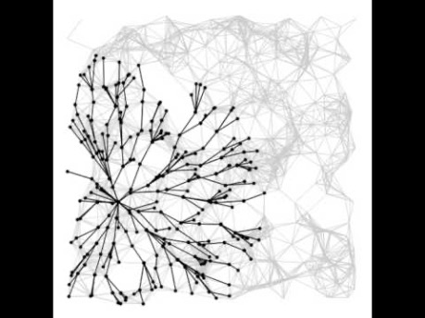
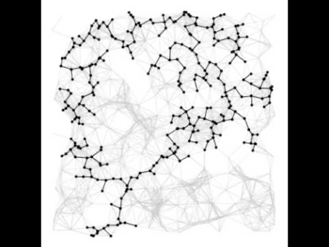
Dijkstra’s versus Prim’s
Dijkstra’s Algorithm
Dijkstra’s proceeds radially from its source, because it chooses edges by path length from source
Prim’s Algorithm
Prim’s jumps around the graph (the perimeter), because it chooses edges by edge weight (there’s no source)

Slide 29
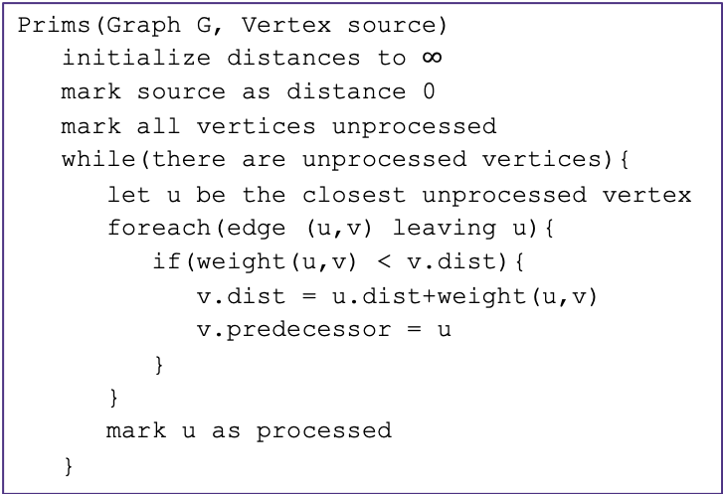
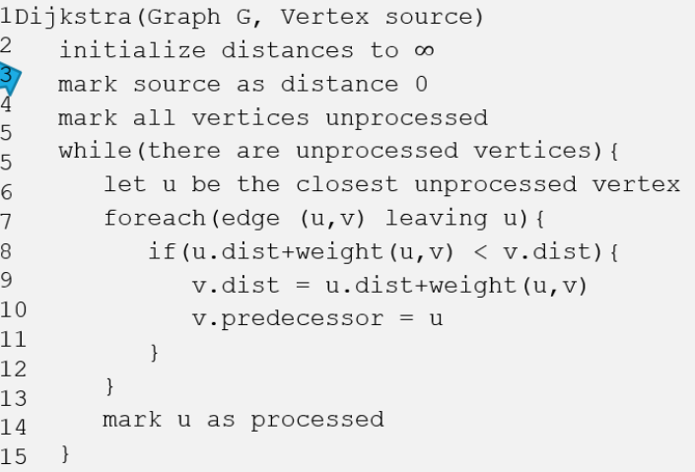
Prim’s Algorithm
Question
Which lines of Dijkstra can we change to create our new algorithm?
Dijkstra’s
Start at source
Update distance from current to unprocessed neighbors
Add closest unprocessed neighbor to solution
Repeat until all vertices have been marked processed
Algorithm idea:
Start at any node
Investigate edges that connect unprocessed vertices
Add the lightest edge that grows connectivity to solution
Repeat until all vertices have been marked processed
1
2
3
4
5
5
6
7
8
9
10
11
12
13
14
15
1
2
3
4
5
5
6
7
8
9
10
11
12
13
14
15

Slide 30
Adapting Dijkstra’s: Prim’s Algorithm
Normally, Dijkstra’s checks for a shorter path from the start.
But MSTs don’t care about individual paths, only the overall weight!
New condition: “would this be a smaller edge to connect the current known set to the rest of the graph?”
primsShortestPath(G graph, V start)
Map edgeTo, distTo;
initialize distTo with all nodes mapped to ∞, except start to 0
PriorityQueue<V> perimeter; perimeter.add(start);
while (!perimeter.isEmpty()):
u = perimeter.removeMin()
known.add(u)
for each edge (u,v) to unknown v with weight w:
oldDist = distTo.get(v) // previous smallest edge to v
newDist = distTo.get(u) + w // is this a smaller edge to v?
if (newDist < oldDist):
distTo.put(u, newDist)
edgeTo.put(u, v)
if (perimeter.contains(v)):
perimeter.changePriority(v, newDist)
else:
perimeter.add(v, newDist)
distTo.get(u) +
KNOWN
C
1
1??
B
3
A
4
3??
1
X

Slide 31
Try It Out
G
50
6
B
2
3
E
primsShortestPath(G graph, V start)
Map edgeTo, distTo;
initialize distTo with all nodes mapped to ∞, except start to 0
PriorityQueue<V> perimeter; perimeter.add(start);
while (!perimeter.isEmpty()):
u = perimeter.removeMin()
known.add(u)
for each edge (u,v) to unknown v with weight w:
oldDist = distTo.get(v) // previous smallest edge to v
newDist = distTo.get(u) + w // is this a smaller edge to v?
if (newDist < oldDist):
distTo.put(u, newDist)
edgeTo.put(u, v)
if (perimeter.contains(v)):
perimeter.changePriority(v, newDist)
else:
perimeter.add(v, newDist)
4
C
5
A
9
2
7
7
F
D
8
Vertex | Distance | Best Edge | Processed
A
B
C
D
E
F
G
-
X
✓
2
(A, B)
✓
4
(A, C)
✓
(A, D)
✓
2
(C, D) .
7
(B, E)
✓
6
(C, E) .
5 .
3
(B, F)
✓
50
(B, G)
✓

Slide 32
A Different Approach
B
2
Suppose the MST on the right was produced by Prim’s
Observation: We basically choose all the smallest edges in the entire graph (1, 2, 3, 4, 6)
The only exception was 5. Why shouldn’t we add edge 5?
Because adding 5 would create a cycle, and to connect A, C, & D we’d rather choose 1 & 4 than 1 & 5 or 4 & 5.
Prim’s thinks “vertex by vertex”, but what if you think “edge by edge” instead?
Start with the smallest edge in the entire graph and work your way up
Add the edge to the MST as long as it connects two new groups (meaning don’t add any edges that would create a cycle)
3
6
11
E
1
C
A
9
5
7
10
4
F
D
8
Building an MST “edge by edge” in this graph:
Add edge 1
Add edge 2
Add edge 3
Add edge 4
Skip edge 5 (would create a cycle)
Add edge 6
Finished: all vertices in the MST!

Slide 33
Kruskal’s Algorithm
“islands”
B
6
This “edge by edge” approach is how Kruskal’s Algorithm works!
4
2
E
1
11
C
A
9
Key Intuition: Kruskal’s keeps track of isolated “islands” of vertices (each is a sub-MST)
Start with each vertex as its own “island”
If an edge connects two vertices within the same “island”, it forms a cycle! Discard it.
If an edge connects two vertices in different “islands”, add it to the MST! Now those “islands” need to be combined.
5
7
10
3
D
8
F
kruskalMST(G graph)
Set(?) msts; Set finalMST;
initialize msts with each vertex as single-element MST
sort all edges by weight (smallest to largest)
for each edge (u,v) in ascending order:
uMST = msts.find(u)
vMST = msts.find(v)
if (uMST != vMST):
finalMST.add(edge (u, v))
msts.union(uMST, vMST)

Slide 34
Kruskal’s Algorithm
“islands”
B
6
This “edge by edge” approach is how Kruskal’s Algorithm works!
4
2
E
1
11
C
A
9
Key Intuition: Kruskal’s keeps track of isolated “islands” of vertices (each is a sub-MST)
Start with each vertex as its own “island”
If an edge connects two vertices within the same “island”, it forms a cycle! Discard it.
If an edge connects two vertices in different “islands”, add it to the MST! Now those “islands” need to be combined.
5
7
10
3
D
8
F
kruskalMST(G graph)
Set(?) msts; Set finalMST;
initialize msts with each vertex as single-element MST
sort all edges by weight (smallest to largest)
for each edge (u,v) in ascending order:
uMST = msts.find(u)
vMST = msts.find(v)
if (uMST != vMST):
finalMST.add(edge (u, v))
msts.union(uMST, vMST)

Slide 35
Kruskal’s Algorithm
“islands”
B
6
This “edge by edge” approach is how Kruskal’s Algorithm works!
4
2
E
1
11
C
A
9
Key Intuition: Kruskal’s keeps track of isolated “islands” of vertices (each is a sub-MST)
Start with each vertex as its own “island”
If an edge connects two vertices within the same “island”, it forms a cycle! Discard it.
If an edge connects two vertices in different “islands”, add it to the MST! Now those “islands” need to be combined.
5
7
10
3
D
8
F
kruskalMST(G graph)
Set(?) msts; Set finalMST;
initialize msts with each vertex as single-element MST
sort all edges by weight (smallest to largest)
for each edge (u,v) in ascending order:
uMST = msts.find(u)
vMST = msts.find(v)
if (uMST != vMST):
finalMST.add(edge (u, v))
msts.union(uMST, vMST)

Slide 36
Kruskal’s Algorithm
“islands”
B
6
This “edge by edge” approach is how Kruskal’s Algorithm works!
4
2
E
1
11
C
A
9
Key Intuition: Kruskal’s keeps track of isolated “islands” of vertices (each is a sub-MST)
Start with each vertex as its own “island”
If an edge connects two vertices within the same “island”, it forms a cycle! Discard it.
If an edge connects two vertices in different “islands”, add it to the MST! Now those “islands” need to be combined.
5
7
10
3
D
8
F
kruskalMST(G graph)
Set(?) msts; Set finalMST;
initialize msts with each vertex as single-element MST
sort all edges by weight (smallest to largest)
for each edge (u,v) in ascending order:
uMST = msts.find(u)
vMST = msts.find(v)
if (uMST != vMST):
finalMST.add(edge (u, v))
msts.union(uMST, vMST)

Slide 37
Kruskal’s Algorithm
“islands”
B
6
This “edge by edge” approach is how Kruskal’s Algorithm works!
4
2
E
1
11
C
A
9
Key Intuition: Kruskal’s keeps track of isolated “islands” of vertices (each is a sub-MST)
Start with each vertex as its own “island”
If an edge connects two vertices within the same “island”, it forms a cycle! Discard it.
If an edge connects two vertices in different “islands”, add it to the MST! Now those “islands” need to be combined.
5
7
10
3
D
8
F
kruskalMST(G graph)
Set(?) msts; Set finalMST;
initialize msts with each vertex as single-element MST
sort all edges by weight (smallest to largest)
for each edge (u,v) in ascending order:
uMST = msts.find(u)
vMST = msts.find(v)
if (uMST != vMST):
finalMST.add(edge (u, v))
msts.union(uMST, vMST)

Slide 38
Kruskal’s Algorithm
“islands”
B
6
This “edge by edge” approach is how Kruskal’s Algorithm works!
4
2
E
1
11
C
A
9
Key Intuition: Kruskal’s keeps track of isolated “islands” of vertices (each is a sub-MST)
Start with each vertex as its own “island”
If an edge connects two vertices within the same “island”, it forms a cycle! Discard it.
If an edge connects two vertices in different “islands”, add it to the MST! Now those “islands” need to be combined.
5
7
10
3
D
8
F
kruskalMST(G graph)
Set(?) msts; Set finalMST;
initialize msts with each vertex as single-element MST
sort all edges by weight (smallest to largest)
for each edge (u,v) in ascending order:
uMST = msts.find(u)
vMST = msts.find(v)
if (uMST != vMST):
finalMST.add(edge (u, v))
msts.union(uMST, vMST)

Slide 39
Try It Out
B
3
6
E
KruskalMST(Graph G)
initialize each vertex to be its own component
sort the edges by weight
foreach(edge (u, v) in sorted order){
if(u and v are in different components){
add (u,v) to the MST
Update u and v to be in the same component
}
}
2
1
C
A
10
5
9
7
4
D
F
8
Edge | Include? | Reason
(A,C)
(C,E)
(A,B)
(A,D)
(C,D)
Edge (cont.) | Inc? | Reason
(B,F)
(D,E)
(D,F)
(E,F)
(C,F)

Slide 40
Try It Out
B
3
6
E
KruskalMST(Graph G)
initialize each vertex to be its own component
sort the edges by weight
foreach(edge (u, v) in sorted order){
if(u and v are in different components){
add (u,v) to the MST
Update u and v to be in the same component
}
}
2
1
C
A
10
5
9
7
4
D
F
8
Edge | Include? | Reason
(A,C)
(C,E)
(A,B)
(A,D)
(C,D)
Edge (cont.) | Inc? | Reason
(B,F)
(D,E)
(D,F)
(E,F)
(C,F)
Yes
Yes
Yes
No
Cycle A,C,E,D,A
Yes
No
Cycle A,D,F,B,A
Yes
No
Cycle A,C,E,F,D,A
No
Cycle A,C,D,A
No
Cycle C,A,B,F,C

Slide 41
Kruskal’s Implementation
KruskalMST(Graph G)
initialize each vertex to be its own component
sort the edges by weight
foreach(edge (u, v) in sorted order){
if(u and v are in different components){
add (u,v) to the MST
Update u and v to be in the same component
}
}
Some lines of code there were a little sketchy.
> initialize each vertex to be its own component > Update u and v to be in the same component
Can we use one of our data structures?

Slide 43
That’s all!

